Slide 1


Code Challenge by Codebasics
This challenge is to create a dashboard on the customer analysis and there spending pattern for introducing new credit card by Mitron bank. - Rahul Rajan

Slide 2
Problem Statement
Mitron Bank is a legacy financial institution headquartered in Hyderabad. They want to introduce a new line of credit cards, aiming to broaden its product offerings and reach in the financial market.
AtliQ Data Services came to know about this through an internal link and approached Mitron Bank with a proposal to implement this project. However, strategy director of Mitron Bank, Mr.Bashnir Rover is skeptical and asked them to do a pilot project with the sample data before handing them the full project. They provided a sample dataset of 4000 customers across five cities on their online spend and other details.
Peter Pandey is a data analyst at AtliQ Data Services and asked by his manager to take over this project. His role is to analyse the provided sample data and report key findings to the strategy team of Mitron Bank. This analysis is expected to guide them in tailoring the credit cards to customer needs and market trends.
The successful acquisition of this project depends on Peter's ability to provide actionable, data-driven recommendations and impress Mr. Bashnir Rover & his team. Peter requested support from his manager Tony Sharma, and he provided him with some ideas to generate insights based on the data provided.

Slide 3
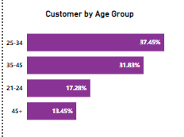
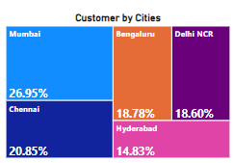
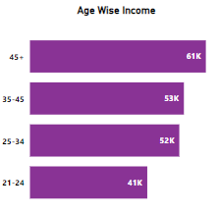
Customer By Cities, Age Group And Income
Initially we need to analyze the number of people in the cities, age group and wise of the Mitron Bank customers. There we need to introduce new card for 3 months in the major cities, if there is a positive response then try to bring an update on that. If negative try to find the reason behind it and also try to conduct survey to get in depth details.

Slide 4
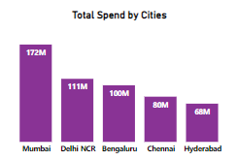
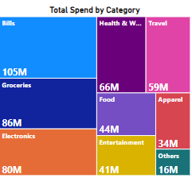
Which City Spends The Most And On Which Category They Spend?
So the Mumbai spends of the most since the cost of living in more compare to the other cities in India. Since 48% of the total spending goes to the bills, Groceries, Health since these are very important for a person.

Slide 5
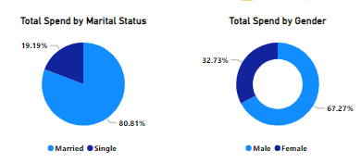
Who Spends The Most Boy Or Girl Or Married Couples?
The data shows that the men spend more compared to women, one of the reason that person will be the solo earner of the family. Married couple spends more than other, even in married couples sometimes men will be the only person working for a while. This data is for 4000 customers only.

Slide 6
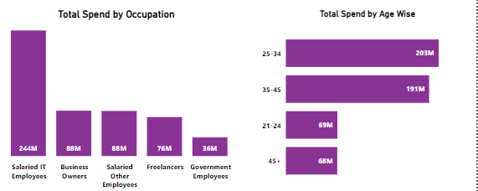
Age Group And Employee Contribute the Most
So salaried peoples contribute the most of the spending according to the data. We can analyze that most of the salaried people age within 25-45 . Normally, business and freelancers also contribute the most. But government employees are spending the least, so need to analyze that and try to bring a good offers for them.

Slide 7
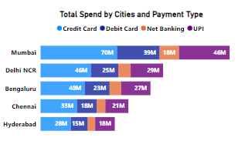
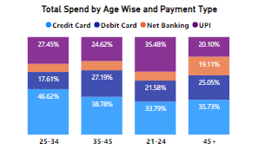
Cities by Payment Type and Age Wise
So Mumbai city uses Credit card the most, also the age group of 25-34 contributes 46% for using the credit card. In this age group most of them will be a solo earner of the family, will get married and try to purchase household items using credit card in the form of EMI, so that the reason for increase in usage of credit card. Need to analyze more of Chennai and Hyderabad cities about the credit card usage, also concentrate more on 35-45 age groups.

Slide 8
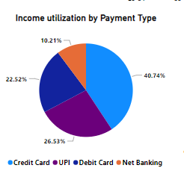
Income Utilization based on Payment type
Credit card and UPI have the highest income utilization, since most of the people are paying there bills using credit cards like EMI etc. Net banking has the least income utilization percentage.

Slide 9
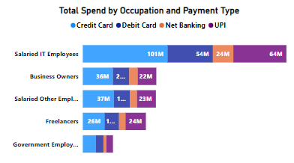
Occupation by Payment type
IT employee use credit card more for there purpose to pay the bills and other uses, they even use other payment mode but it’s way less compared to credit card. The least is government employees, need analyze and bring new offers for them.

Slide 10
Recommendation
Tailor credit card offerings to specific customer segments identified in the analysis, such as frequent travelers, online shoppers, or small business owners. This customization enhances relevance and appeal.
Design reward structures that align with the spending patterns identified in the dataset. For example, offer bonus points or cashback on categories where customers spend the most, such as dining, travel, groceries or fuel rewards.
Customize benefits to customer preferences, offering exclusive partner discounts, travel insurance, and concierge services. Improve digital experience with mobile wallet integration, real-time notifications, and intuitive expense tracking, enhancing convenience.
Robust security features including two-factor authentication, fraud alerts, and advanced encryption are essential safeguards.

Slide 11
Credit Card Recommendation
Educate customer about the credit card benefits, usage and offers so that we can get a positive response from the customer end.
Offering complimentary one-year credit card usage followed by nominal annual fees can drive user acquisition and retention.
Customizing offers to match spending patterns, particularly for specific categories, optimizes individual customization and usage incentives.

Slide 12
Thank you
- Rahul Rajan

